Slide 1
RegEx and Collections

Slide 2
Regular Expressions
Pattern matching search
http://www.regexr.com/
http://regexlib.com/CheatSheet.aspx?AspxAutoDetectCookieSupport=1

Slide 3
RegEx Code Snippets
Regex reg = new Regex(@"[a-z]");
String.Format("IsMatch: {0}", reg.IsMatch("abc"));
String.Format("Match: {0}", reg.Match("abc"));
foreach (Match m in reg.Matches("abc"))
String.Format("Matches: {0} ",m.Value);

Slide 4
Collections
Dynamic groups of objects
Lists
SortedSets
Queues
Stacks
Dictionaries
SortedLists
Hashtables
HashSets

Slide 5
Lists and SortedSets
Collection of Objects
Type specific
Lists
List<T> name = new List<T>();
Sorted Sets are …. Sorted!
SortedSet<T> name = new SortedSet<T>();

Slide 6
Queues and Stacks
Ordered
Can be type specific or not
Queues
FIFO (First In First out)
Queue<T> name = new Queue<T>();
Stacks
LIFO (Last in First out)
Stack<T> name = new Stack<T>();

Slide 7
HashTables and Dictionaries
Keyed Collections:
Hash Tables
Use a hash of a key to associate a value for quick look up.
Dictionaries
Use typed keys for look up.
[“Apple”] = “value1”
[2] = “value2”
[132.32] = “value3”
[555] = “value4”
[“Frog”] = “value5”
[TRUE] = “value6”
[D7281] = “value1”
[43F67] = “value2”
[782E4] = “value3”
[72345] = “value4”
[A452B] = “value5”
[AF45D] = “value6”
[“Apple”] = “red”
[“Banana”] = “yellow”
[“Pear”] = “green”
[“Kiwi”] = “brown”
[“Orange”] = “orange”
[“Grape”] = “purple”

Slide 8
SortedLists, Sorted Dictionaries
Sorted Lists
Sorted based on key
SortedList<T,T> name = new SortedList<T,T>();
Sorted Dictionary
Sorted based on key
SortedDictionary<T,T> name = new SortedDictionary<T,T>();
The SortedList<TKey, TValue> generic class is an array of key/value pairs with O(log n) retrieval, where n is the number of elements in the dictionary. In this, it is similar to the SortedDictionary<TKey, TValue> generic class. The two classes have similar object models, and both have O(log n) retrieval. Where the two classes differ is in memory use and speed of insertion and removal:
SortedList<TKey, TValue> uses less memory than SortedDictionary<TKey, TValue>.
SortedDictionary<TKey, TValue> has faster insertion and removal operations for unsorted data, O(log n) as opposed to O(n) for SortedList<TKey, TValue>.
If the list is populated all at once from sorted data, SortedList<TKey, TValue> is faster than SortedDictionary<TKey, TValue>.
Another difference between the SortedDictionary<TKey, TValue> and SortedList<TKey, TValue> classes is that SortedList<TKey, TValue> supports efficient indexed retrieval of keys and values through the collections returned by the Keys and Values properties. It is not necessary to regenerate the lists when the properties are accessed, because the lists are just wrappers for the internal arrays of keys and values. The following code shows the use of the Values property for indexed retrieval of values from a sorted list of strings:
https://msdn.microsoft.com/en-us/library/ms132319.aspx

Slide 9
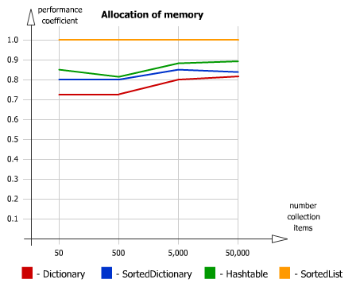
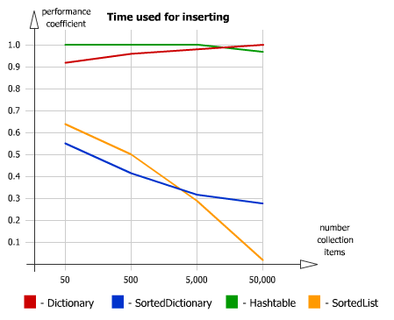
Which to use?
http://blog.bodurov.com/Performance-SortedList-SortedDictionary-Dictionary-Hashtable

Slide 10
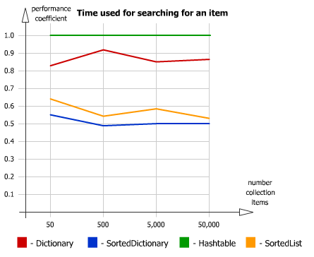
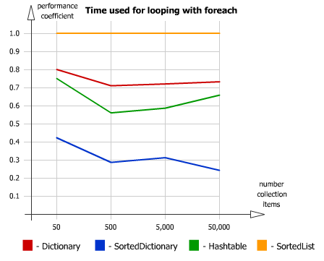
Which to use?
http://blog.bodurov.com/Performance-SortedList-SortedDictionary-Dictionary-Hashtable

Slide 11
Summary Initializations
List<int> lstI = new List<int>(); // dynamic collection
HashSet<int> hashI = new HashSet<int>(); // used to removed duplicates
Hashtable hashT = new Hashtable(); // requires Collection Namespace -- Type independant
Dictionary<int, string> dictI = new Dictionary<int, string>(); // typed key and value pairs
SortedDictionary<int, string> sortDict = new SortedDictionary<int, string>(); // stored based on Key
SortedSet<int> sortS = new SortedSet<int>(); // sorted based on value
SortedList sList = new SortedList(); // generic key value types -- sorts based on key
SortedList<int, int> sListI = new SortedList<int,int>(); // type specific
Queue queGen = new Queue(); // generic objects - FIFO
Queue<int> queInts = new Queue<int>(); // type specific - FIFO
Stack stkGen = new Stack(); // generic objects - LIFO
Stack<int> stkInts = new Stack<int>(); // type specific - LIFO

Slide 12
Lambdas
Using a function as a variable
Where(objectIdentifier => {condition true if to return})
lstInts.Where(x => x > 3)
lstPeople.Where(x => x.Name == “Fred”)
Max(objectIdentifier => {value to use}) [and Min]
lstInts.Max(x => x)
lstPeople.Min(x => x.Age)
http://www.dotnetperls.com/lambda
https://msdn.microsoft.com/en-us/library/bb397687.aspx
http://www.codeproject.com/Tips/298963/Understand-Lambda-Expressions-in-minutes

Slide 13
Common Enumerable LINQ Methods
All
Any
Average
Cast
Contains
Distinct
ElementAt
First
FirstOrDefault
GroupBy
Join
Max
Min
Range
Single
Skip
Sum
ToArray
ToDictionary
ToList
Where
https://msdn.microsoft.com/en-us/library/vstudio/system.linq.enumerable_methods%28v=vs.100%29.aspx

Slide 14
LINQ
Microsoft Technology
Create Query Expressions
Retrieve and filter data from data sources

Slide 15
LINQ Providers
Provider is a set of classes the implement LINQ operations such as
Sorting
Grouping Data
Filtering Data (Retrieve data based on a set of conditions)
LINQ To Entities - databases
LINQ To XML
LINQ To Objects
LINQ To Arrays and Lists

Slide 16
LINQ with Arrays
int[] scoresArray = { 75, 59, 92, 17, 66, 95, 89, 92, 93, 75 };
// LINQ Query Statement
var failingScores =
from score in scoresArray
where score < 60
select score;
Query results are placed in the range variable: failingScores
Query is not executed until range variable is referenced

Slide 17
Using Range Variable Values
// Iterate through all values in the range variable: failingScores
foreach (var score in failingScores)
{
displayTextBox.Text += score.ToString() + "\r\n";
}
scoresArray[6] = 52; // Add another failing score
Execute Query Again
int count = failingScores.Count();

Slide 18
Other LINQ Methods
Commonly used LINQ methods
double average = failingScores.Average();
int minScore = failingScores.Min();
int maxScore = failingScores.Max();
int sumScores = failingScores.Sum();
int firstScore = failingScores.ElementAt(0); // access individual item

Slide 19
Sorting Data with LINQ
The orderby clause will sort results in the range variable
int[] scoresArray = { 75, 59, 92, 17, 66, 95, 89, 92, 93, 75 };
var sortedScores =
from score in scoresArray
orderby score descending
select score;
Omit the descending keyword to sort in ascending order

Slide 20
Distinct Values
The Distinct method applied to the query will return only distinct values in the array
int[] scoresArray = { 75, 59, 92, 17, 66, 95, 89, 92, 93, 75 };
var allScores =
(from score in scoresArray
orderby score descending
select score).Distinct();

Slide 21
Filtering with Where and Lambdas
The LINQ Where method can be used with a Lambda expression to filter data.
A lambda expression is an anonymous function that is helpful for writing LINQ query expressions.
For example, the lambda expression x => x * x specifies a parameter that’s named x and returns the value of x squared
=> is called the Lambda Operator

Slide 22
Where and Lambda Example
Linq Query with no Where method
int[] ary = { 1, 2, 3, 4, 5, 6, 7, 8, 9 };
var oddNumbers =
from num in ary
where num % 2 == 1
select num;
Same Query using Where method with Lambda Expression
var oddNums = ary.Where(num => num % 2 == 1);

Slide 23
More Lambda Examples
// Return an IEnumerable<string> with null values removed
string[] array = { "dot", null, "net", null, null, "perls", null };
var noNulls = array.Where(item => item != null);
// Return an IEnumerable<int> with only even numbers
int[] numbers = { 1, 2, 3, 4, 5, 6, 7, 8, 9 };
var evenNumbers = numbers.Where(n => n % 2 == 0);

Slide 24
Data Type of Multi-Valued Range Variable
A range variable can be passed to a method. It's data type is IOrderedEnumerable<datatype>
This method will accept an int range variable as a parameter
private void displayRangeVariable(IOrderedEnumerable<int> values)
{
foreach (var item in values)
{
displayTextBox.Text += item.ToString() + "\r\n";
}
}

Slide 25
Data Type of Scalar Range Variable
The range variable has only one value - an integer
int[] scoresArray = { 75, 59, 92, 17, 66, 95, 89, 92, 93, 75 };
var highScore =
(from score in scoresArray
select score).Max();
int h = highScore;

Slide 26
LINQ To Objects
Clear all text boxes on a form
var textBoxes =
from Control tbox in this.Controls
where tbox is TextBox
select tbox;
foreach (TextBox tb in textBoxes)
{
tb.Clear();
}

Slide 27
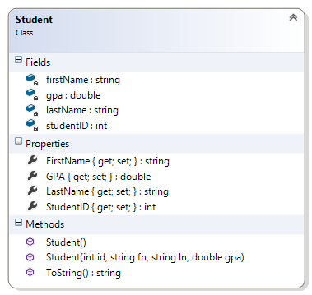
Student Object

Slide 28
Using LINQ With List of Objects
List<Student> myStudents = new List<Student>();
myStudents.Add(new Student(7000, "Mary", "Poppins", 4.00));
myStudents.Add(new Student(9802, "Sally", "Poppins", 3.85));
myStudents.Add(new Student(2700, "Fred", "Flintstone", 1.75));
myStudents.Add(new Student(3367, "Wilma", "Flintstone", 3.94));
myStudents.Add(new Student(4478, "Barney", "Fife", 2.13));
myStudents.Add(new Student(6255, "Roy", "Rogers", 2.87));
myStudents.Add(new Student(1890, "Dale", "Evans", 3.87));
myStudents.Add(new Student(8739, "Mo", "Davis", 1.25));
myStudents.Add(new Student(1222, "Larry", "Fine", 1.97));
myStudents.Add(new Student(1395, "Curly", "Evans", 1.86));
myStudents.Add(new Student(6591, "Willy", "Mays", 3.99));
myStudents.Add(new Student(6991, "Babe", "Ruth", 3.22));
myStudents.Add(new Student(7233, "Hank", "Aaron", 3.54));
myStudents.Add(new Student(1568, "Harry", "Truman", 3.21));

Slide 29
Display Students in GPA Range
var gpaRange =
from student in myStudents
where student.GPA >= 1.5 && student.GPA <= 3.00
orderby student.LastName, student.FirstName
select student;
foreach (var student in gpaRange)
{
displayTextBox.Text += student + "\r\n";
}
Call toString() method

Slide 30
Access Object Properties
var lowGPA =
from student in myStudents
where student.GPA <= 2.00
orderby student.LastName, student.FirstName
select student;
foreach (var student in lowGPA)
{
displayTextBox.Text += student.LastName + " ";
displayTextBox.Text += student.GPA.ToString() + "\r\n";
}

Slide 31
Projecting Data
Using Linq to project fields
var increaseGPA =
from student in myStudents
select new
{
student.LastName,
student.FirstName,
OldGPA = student.GPA,
NewGPA = student.GPA * 1.05 };

Slide 32
Display Projected Data
displayTextBox.Text = "Student Increased GPA\r\n\r\n";
foreach (var student in increaseGPA)
{
displayTextBox.Text += string.Format("{0,-10} {1,-10} {2,5} {3,5}\r\n",
student.FirstName, student.LastName,
student.OldGPA.ToString("f2"),
student.NewGPA.ToString("f2"));
}

